Slide 1

Woodlands Primary School Formby
Woodlands’ Governing Body
Relationship & Sex Education:
parental consultation

Slide 2
Rationale for consultation on RSE [Relationships & Sex Education]:
Welcome to Woodlands’ Governing Body parent & carer consultation on Relationships & Sex Education [RSE]. We hope that this PowerPoint will give you an idea of what we mean by RSE & how it will be taught. We are particularly interested in your views about when to tackle different concepts and any areas you might like further support with at home.
We are aware that there will be differences of opinion, but we will take your views into account when we finalise our policy and curriculum plan. We will share this with you later in the summer term.
As well as this presentation, please look at the materials on the school website:

Slide 3
New Guidance re sex & relationships education
20 years since the last review of the curriculum - the world (and how we interact with each other) has changed dramatically
New - Relationships Education in Primary Schools
Previous recommendations for teaching Personal, Social, Health Education, are now part of the National Curriculum.
Sex Education in Primary Schools remains optional, though in Year 5 & 6 the science curriculum form part of what might be considered as sex education - puberty and reproduction.

Slide 4
Science Curriculum
As part of the science curriculum we teach the following statutory objectives that build understanding about growth and reproduction:
Year One
Identify, name, draw and label the basic parts of the human body and say which part of the body is associated with each sense.
Year Two
Notice that animals, including humans, have offspring which grow into adults (they should not be expected to understand how reproduction occurs).
Year Five and Year Six
Describe the life process of reproduction in some plants and animals. They should learn about the changes experienced in puberty.

Slide 5
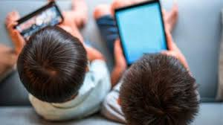

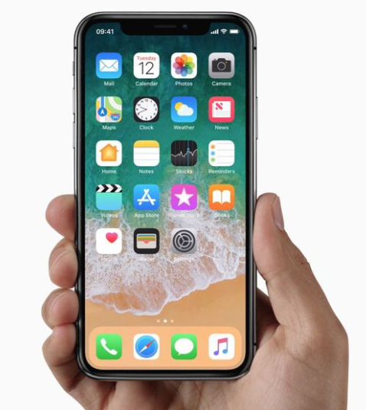
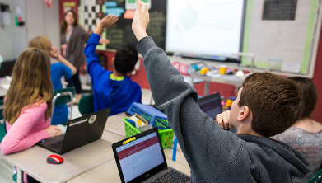

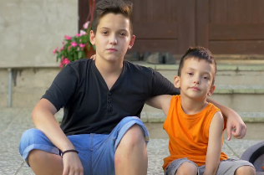
Where and how did you learn about sex and relationships?
For young people today, their learning comes from…
Friends
Television
Internet
School
Parents & Carers
Older siblings

Slide 6
Why is Relationships & Sex Education important for both primary & secondary pupils?
    Entitlement
    Puberty is starting earlier - for some children by age 9
    Unwanted conceptions
    Sexually transmitted infections
    Safeguarding / keeping children safe
      Grooming
      Child Sexual Exploitation
      Abuse
      Sexting
      Online pornography

Slide 7
    What is effective Relationships & Sex Education?
      Age appropriate
      Based on needs of pupil (see later slides)
      Progressive
      Inclusive
      Delivered by trained staff in a safe environment
      Prepares children adequately for puberty in a timely way
      Prepares children for adult life
      Promotes positive relationships

Slide 8
  Those receiving good quality RSE throughout primary & secondary school are more likely to:
    Delay their first sexual experience
    Use condoms for contraception
    Have fewer sexual partners
      Kirby 2007

Slide 9
  Your rights as a parent…
  To be informed of the RSE curriculum and policy
  To be consulted about changes to these
  To withdraw your child from Sex education lessons (that are outside of, or additional to, the Science National Curriculum)

Slide 10
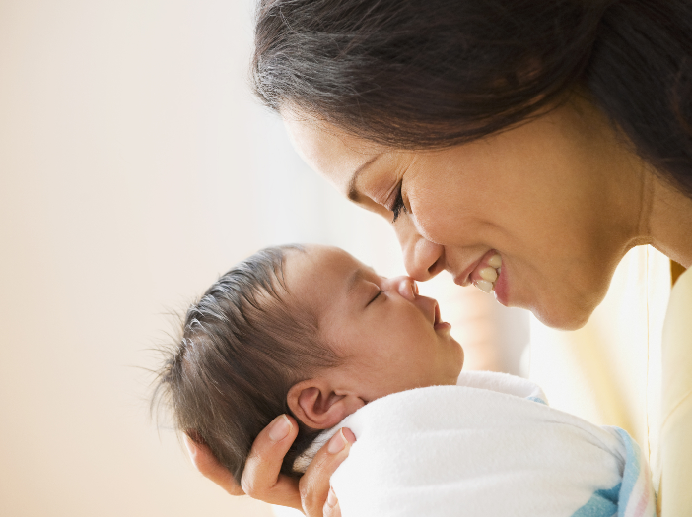
Finding out from children about what they already know / need to know about Relationships and Sex:
We asked Year 2, Year 4 & Year 5 the following questions
Is there anything about people and relationships (such as similarity and difference, respect, positive relationships, families) that you would like to learn about NOW?
Is there anything about people and relationships (such as similarity and difference, respect, positive relationships, families) that you would like to learn about LATER?
Is there anything about managing growing up and changing, including puberty, (such as feelings, hygiene, confidence, bodies) that you would like to learn about NOW?
Is there anything about managing growing up and changing, including puberty, (such as feelings, hygiene, confidence, bodies) that you would like to learn about LATER?
In addition they were asked:
‘Tell me about this picture’
What do you know about how the baby gets out?
What do you know about where babies come from?

Slide 11
What did Woodlands’ children say they needed to know?
Analysis of the first 4 questions answered by Year 4 and 5, the following themes recur:
Divorce
LGBTQ
Racism
On-line relationships
Bullying
Year 4 - being informed about puberty
Year 5 - being informed earlier about puberty and hygiene
Girlfriends/boyfriends
Managing feelings
Hygiene
Self-image

Slide 12
Tell me about this picture
Year 2: The mum is holding a baby. The baby has been born. Mummy is looking after it. Mum is giving it love. Baby’s eyes are closed. It is very small because it has just come out. Mummy is looking at the baby as it has just been born. Mummy is happy she and the baby survived. Baby has just come out of mummy. Baby cannot open its eyes as it has just been born. | Year 4: Mum is holding the baby and trying to make it laugh. A woman is holding a new born baby because it is better out than in. A loving mother who has just got her baby. It is showing the love and relationship between a mother and child. The mother and baby have a happy relationship. This picture shows a mother in a great relationship with her baby and they love each other. | Year 5: A mother has given birth to a child and is hugging it. This shows a new relationship has started. The mother is caring for her new born baby. It is a mum bonding with her child. It is the beginning of a special bond between mother and son after the mother has produced the baby. There is a woman with her new born baby and she looks very happy and ready to be a mother.

Slide 13
What do you know about where babies come from?
Year 2: You eat a seed and you get pregnant. Mummy has an egg in her tummy that hatches. They come from doctors. You can adopt them. A yolk sac on the side of the tummy. Mummies make them. You can buy them. A tummy. Hospital. From someone else’s tummy. | Year 4: Girls’ stomach I think they come from God. I think there are 2 ways to have a baby - either you have to push the baby out or a nurse or someone cuts your belly and carries it out. From ladies if they are married or if you’re lucky. Babies come from a woman’s vulva or vagina and you make babies by having sex with a man. I don’t want to answer… | Year 5: Babies are made up of male and female cells mixing together and come from women’s private parts. When two people of different genders have sex the sperm goes into a woman and it creates a baby. No but you might eat something. I know that a technique called ‘sex’ is used to produce babies for women. This question is very uncomfortable.

Slide 14
What do you know about how the baby gets out?
Year 2: You have an operation. You push your belly down. Doctors split mummy’s tummy and get the baby out. Mummy pushes the baby out or it is cut out. Mummy has special medicine. You cut a circle in the tummy and get the baby out. Put a blanket over mummy and use force to get the baby out. When the yolk sac runs out, doctors get the baby out. | Year 4: They come out through the belly button and it used to be your mouth when you were a child in your birth mum. I know when a woman’s water breaks the baby is ready to come out and it comes out head first. Pulling it out. Well I know sometimes they have to cut your belly open. A zip on the stomach. They go to hospital and push. I don’t want to answer. The babies grow in their mum’s belly and they come out the mum’s vagina or vulva. | Year 5: After 9 months, the baby has finished developing and it might be early or late but the person’s water breaks and they go to the hospital to give birth. It comes out of the mum’s privates. Through the female’s vagina into the world. The mum has to push then the doctor pulls the baby out. They use a knife and open the stomach and then it is there. I do not know so I would like to learn about this. It goes through a disturbing process. Too rude to say.

Slide 15
Ofsted recommendations for schools:
Introduce children to the correct scientific terms to describe body parts in Key Stage 1
Explore/ challenge gender roles/ stereotypes
Begin to explore puberty changes by the age of 8/9
Deliver RSE in a progressive way across the school
Ensure that children in Year 5 and 6 receive RSE input around puberty so that they are prepared as soon as possible for the onset of puberty
For some sessions on Sex Education consider single gender sessions

Slide 16
Summary
Parents have the right to withdraw children from Sex Education lessons at Woodlands that go beyond the content in the Science National Curriculum.
Topics covered related and linked to the Science Curriculum are statutory and not optional to teach. This is as follows:
    In Key Stage 1, children learn that animals, including humans, have offspring that grow into adults. They should be introduced to the concepts of reproduction and growth but not how reproduction occurs.
    In Upper Key Stage 2 (Year 5/6), children are taught about the life cycles of humans and animals, including reproduction. They also learn about the change that happen in humans from birth to old age. This includes learning about what happens in puberty.
Woodlands’ has the right and obligation to teach RSE topic to prepare children for life when they leave school.
The curriculum on Relationships and Sex Education should complement, and be supported by, the school’s wider policies on behaviour, bullying and safeguarding (PSHE; E-Safety, Relationships etc).

Slide 17
Next Steps:
Please look at the materials on the school website:
Please respond to the survey:
  https://forms.gle/DZoZ5TRKqE7Xz6aZ6
We are particularly interested in your views about when to tackle different concepts and any areas you might like further support with at home.
We are aware that there will be differences of opinion, but we will take your views into account when we finalise our policy and curriculum plan.
We will share this with you later in the summer term.

Slide 18
Thank you!

